Slide 1



Step-by-step introduction to Identity Management using PowerShell
Name: Chris Thomas Title: Desktop Engineer Organization: Ingham ISD
Email: cthomas@inghamisd.org
Twitter: @AutomateMyStuff
Name: Eric Krebill Title: Technology Director Organization: Tri County Area Schools
Email: ekrebill@tricountyschools.com
Twitter: @Eric_MAEDS

Slide 2

Step-by-step introduction to Identity Management using PowerShell
For several years, Chris Thomas and Eric Krebill have presented at MAEDS events about creating an identity management tool using PowerShell as the foundation. While these sessions were beneficial for some, not everyone had the time or the background knowledge to take what was presented and put it into practice.
The purpose of this session will be to take a look at these scripts from the beginning to learn how they work and step-by-step walkthrough of how to make scripts that will be ready to work in your district.
This session is intended to be a beginner level session for those with little working knowledge of PowerShell or of how to utilize PowerShell in an identity management system.

Slide 3

Be The Master
“Teaching does not always feel rewarding. It doesn’t need to be. It is a repayment of something that was done for you. It is not a good thing that you do; it is an obligation that you have.”
https://donjones.com/2017/10/19/become-the-master-or-go-away/
Notes:
Be The Master -> Workshops -> Retired Book?!? -> Soft Skills Book with Manning …
https://donjones.com/2020/07/27/more-details-the-fate-of-be-the-master-and-lets-talk-business/
I still believe in the idea.

Slide 4

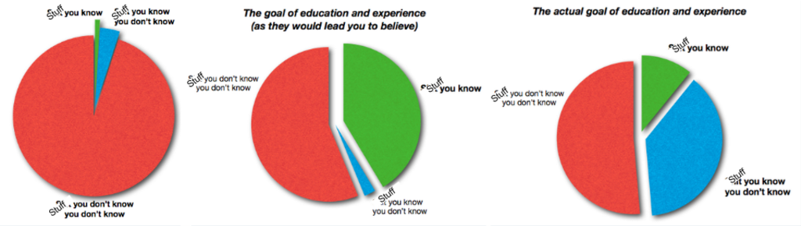
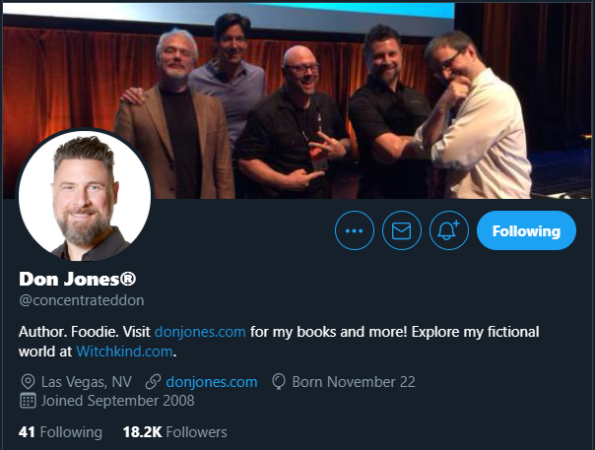
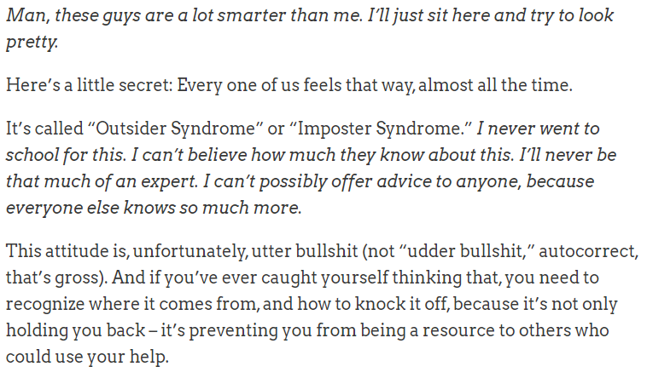
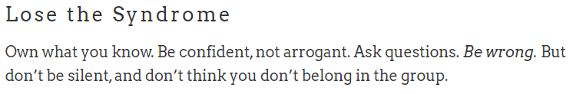

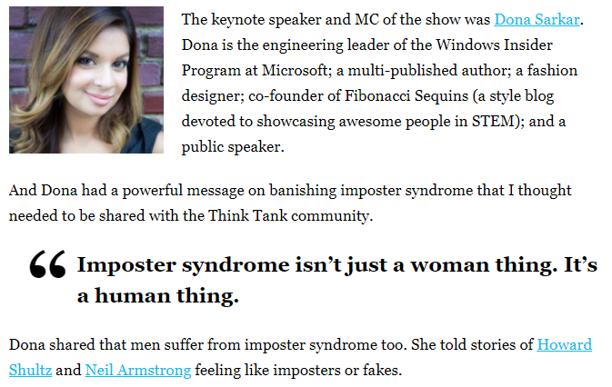


Slide 5
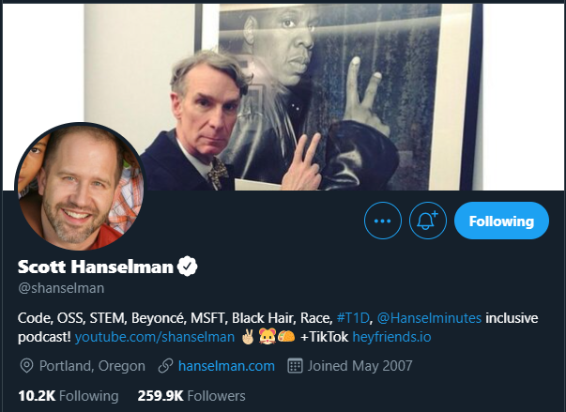
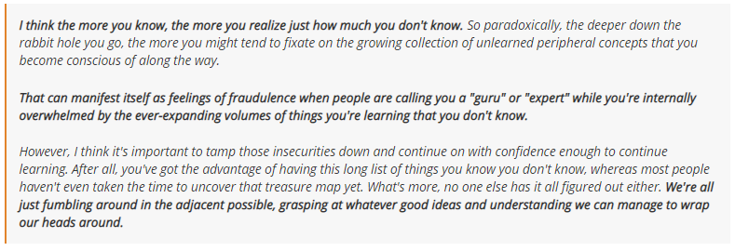

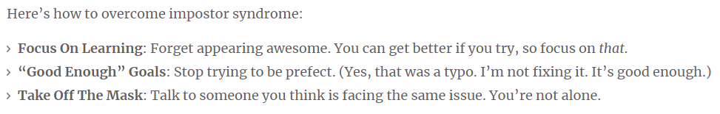
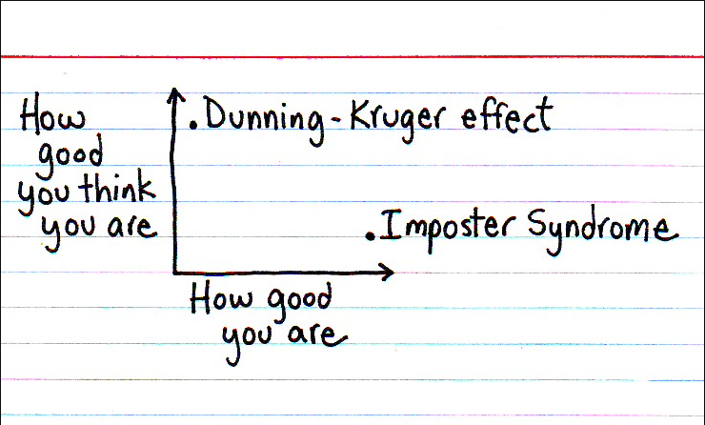

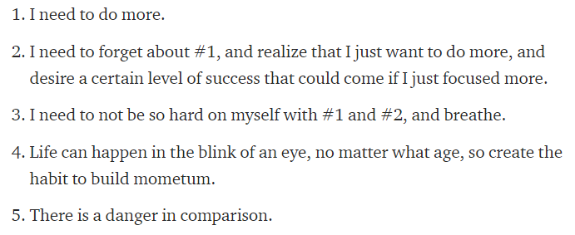

Slide 6
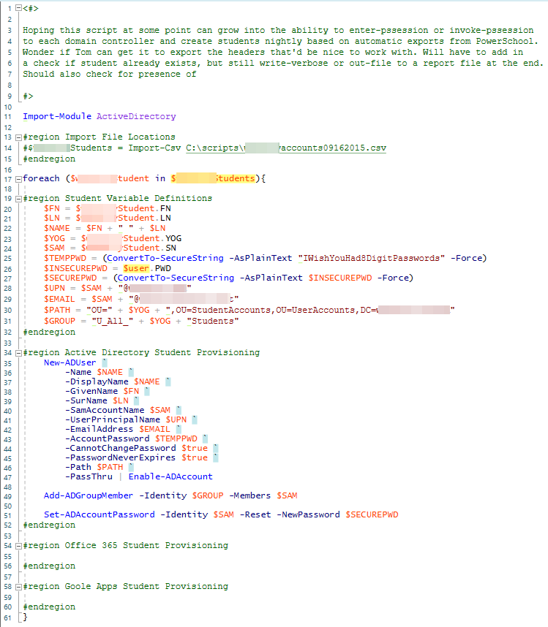
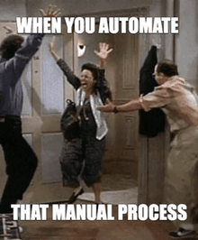

How It All Began…
Secretary / Registrar Enrolls Student In SIS
Secretary / Registrar Fills Out Google Form For Student Account Creation Process
Google Form Sends Email To Help Desk Which Generates A Ticket For That One Student
Help Desk Staff Manually Creates Student Account (Active Directory, Google, Office365)
Help Desk Staff Manually Adds Student Account To Appropriate Groups And Distribution Lists
Help Desk Staff Manually License Student Account
Help Desk Staff Close Ticket And Inform Staff
Help Desk Staff Manually Update Student Credentials In SIS For Staff Reference

Slide 7
PowerShell “Basics”

Slide 8
Vocabulary 01/02
Let’s get on the same page with our language…
Shell: the command interpreter that is used to pass commands to the operating system
ISE: the Integrated Scripting Environment is an application where you can run, test, and debug scripts in a single GUI with tab completion, syntax coloring, selective execution, and context-sensitive help
Cmdlet: a task-oriented command that is typically used to return a .NET Framework object to the next command in the pipeline
Variable: a name given to stored information, e.g. $users, $iWishYouHadAStrongPassword, $x
Parameter: input values or arguments used by the cmdlet or script to make it more dynamic
Named:
Positional:
Switch:
Object: a representation of something with methods to take actions against it and properties to access information stored within it

Slide 9
Vocabulary 02/02
Let’s get on the same page with our language…
Module: a set of related Windows PowerShell functionalities, grouped together as a convenient unit (usually saved in a single directory)
Script Module: a file (.psm1) that contains PowerShell code for functions, variables and more
Binary Module: a .NET Framework assembly (.dll) that contains compiled code
Dynamic Module: a module that only exists in memory (Import-PSSession)
Pipeline ( | ): a method to send the results of the preceding command as input to the next command
$_: “the current object in the pipeline", or "this", or $PSItem
Function: a command or series of commands grouped to run together
Alias: shortcut to a command, cmdlet or function
Array: a data structure that serves as a collection of multiple items. You can iterate over the array or access individual items using an index
Comment: You can type a comment symbol (#) before each line of comments, or you can use the (<#) and( #>) symbols to create a comment block
Escape Character: the grave-accent (`) is a continuation character if used at end of line or displays literal value of a string / variable
Command History: <up arrow> or <down arrow> and Get-History

Slide 10
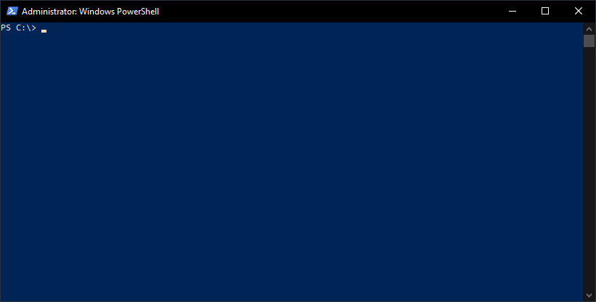
Tab Expansion
PS C:\> new-adu<TAB>
PS C:\> New-ADUser -<TAB>
<TAB> to advance through parameters
or
<SHIFT+TAB> to go back to a previous parameter
PS C:\> New-ADUser -<CTRL + SPACE>
<ARROW KEYS> + <SPACE> to select appropriate parameter
https://docs.microsoft.com/en-us/powershell/scripting/learn/using-tab-expansion

Slide 11
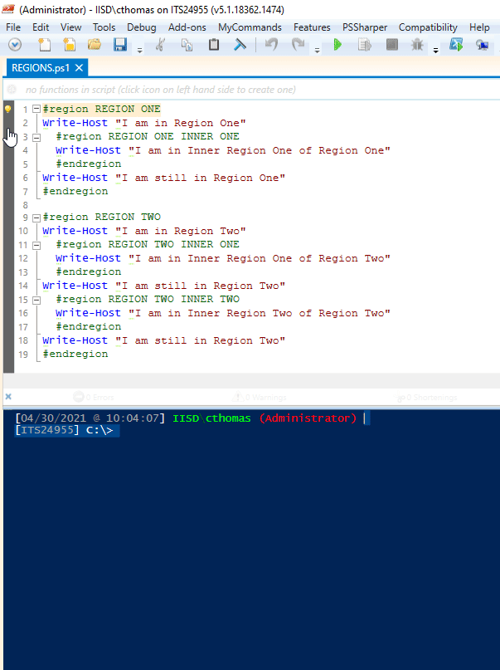
Regions
Separate code into collapsible sections
<CTRL> + M to collapse/expand all regions
Collapsing regions only affects readability, not runability
https://devblogs.microsoft.com/scripting/use-regions-in-powershell-ise-2/

Slide 12
Command Syntax
<command-name> -<Required Parameter Name> <Required Parameter Value>
[-<Optional Parameter Name> <Optional Parameter Value>]
[-<Optional Switch Parameters>]
[-<Optional Parameter Name>] <Required Parameter Value>
https://docs.microsoft.com/en-us/powershell/module/microsoft.powershell.core/about/about_command_syntax

Slide 13
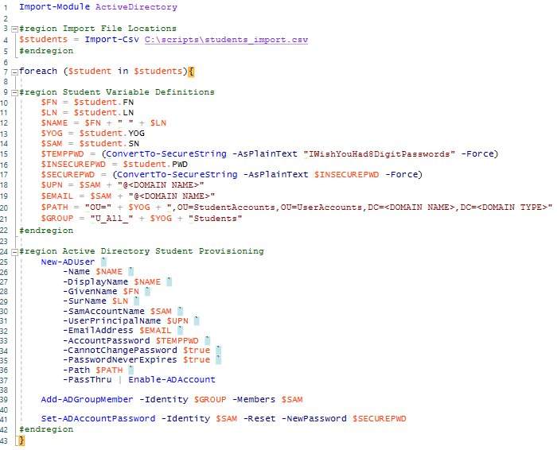
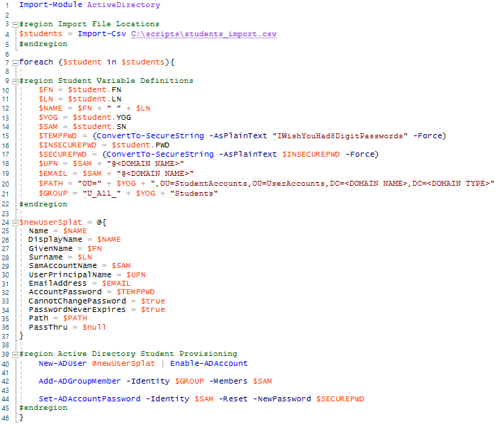
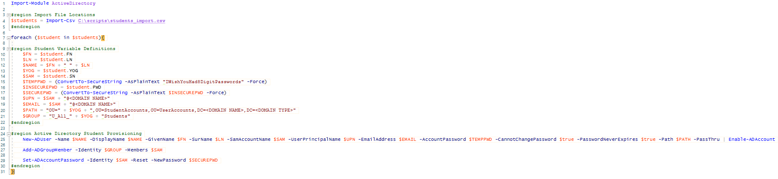
Splatting
Remove the need for horizontal scrolling
Remove the need for backticks (or troubleshooting forgotten backticks…)
Cleaner look to the script
https://docs.microsoft.com/en-us/powershell/module/microsoft.powershell.core/about/about_splatting

Slide 14
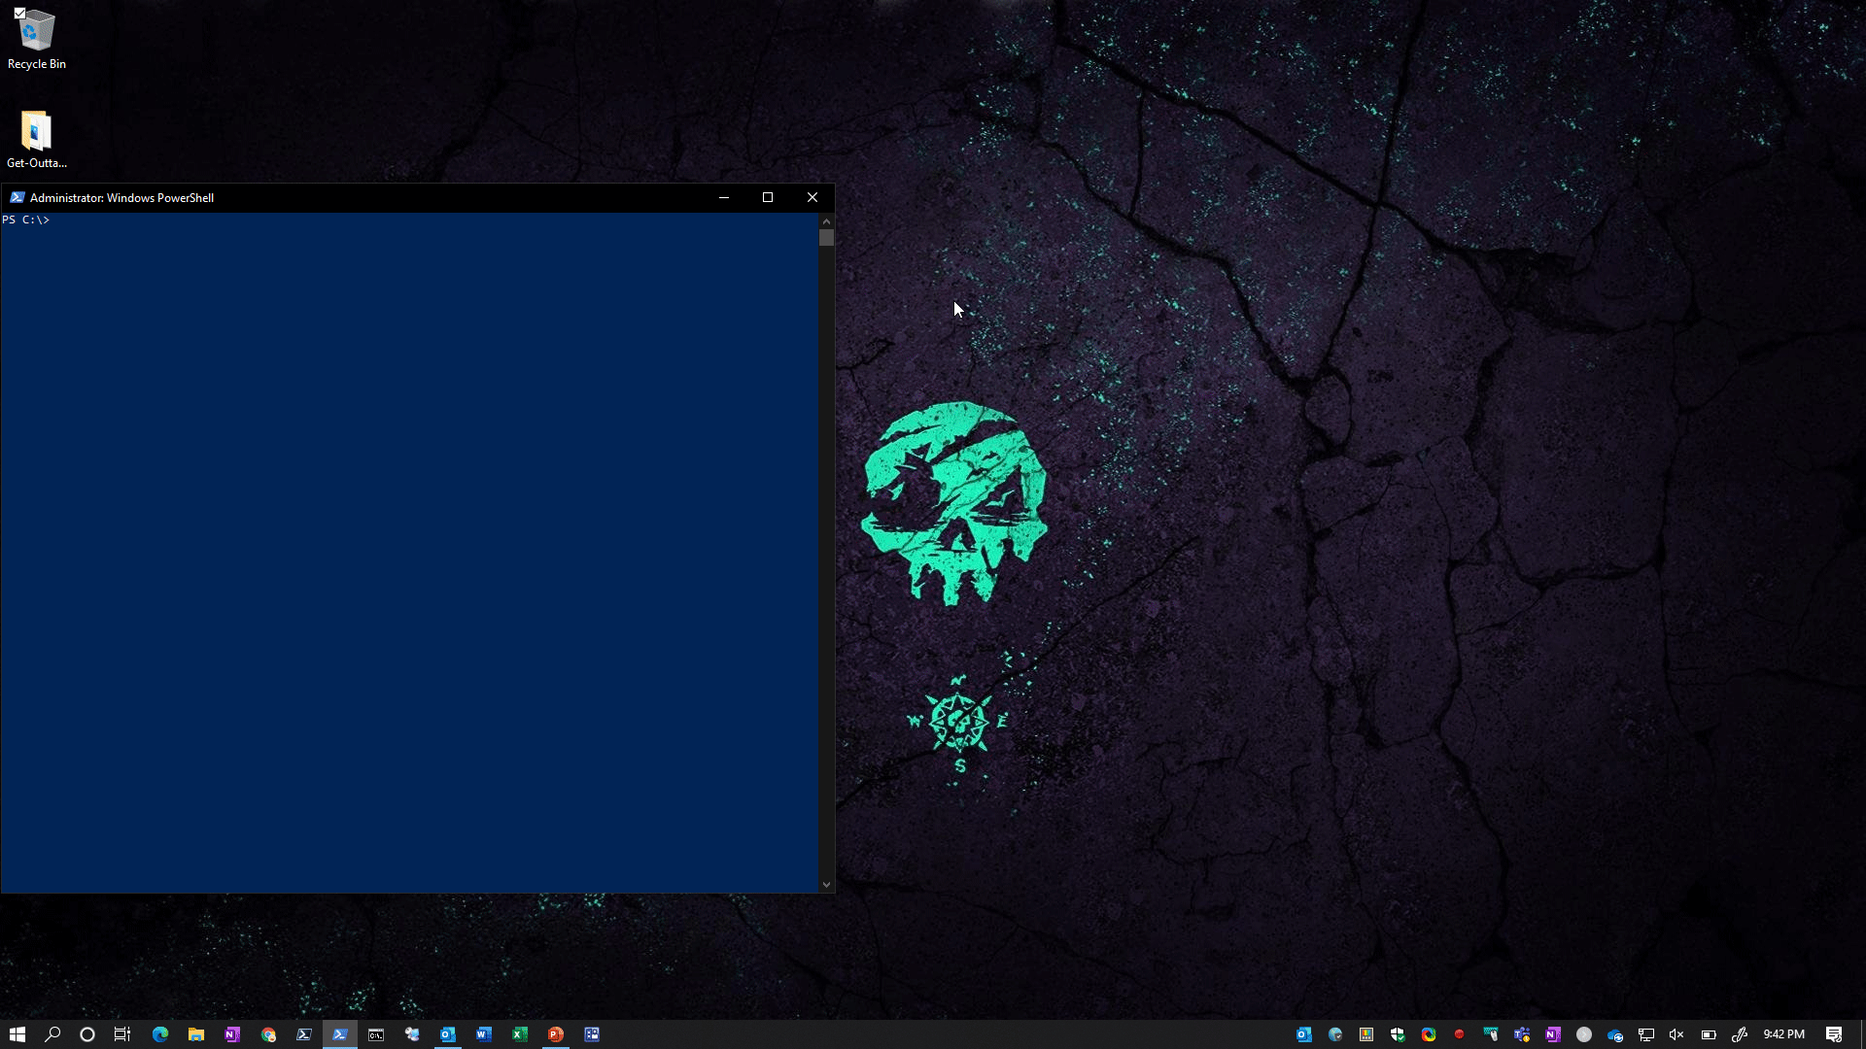
Get-Help
PS C:\> Get-Help New-ADUser
PS C:\> Get-Help New-ADUser -Examples
PS C:\> Get-Help New-ADUser -Full
PS C:\> Get-Help New-ADUser -ShowWindow
PS C:\> Get-Help New-ADUser -Online
https://docs.microsoft.com/en-us/powershell/scripting/learn/ps101/02-help-system
https://docs.microsoft.com/en-us/powershell/module/microsoft.powershell.core/get-help

Slide 15
Get-Command
PS C:\> Get-Command -Module ActiveDirectory
PS C:\> Get-Command -Verb New
PS C:\> Get-Command -Verb New -Noun AD*
PS C:\> Get-Command New-AD*
PS C:\> Get-Command New-ADUser
https://docs.microsoft.com/en-us/powershell/module/microsoft.powershell.core/get-command

Slide 16
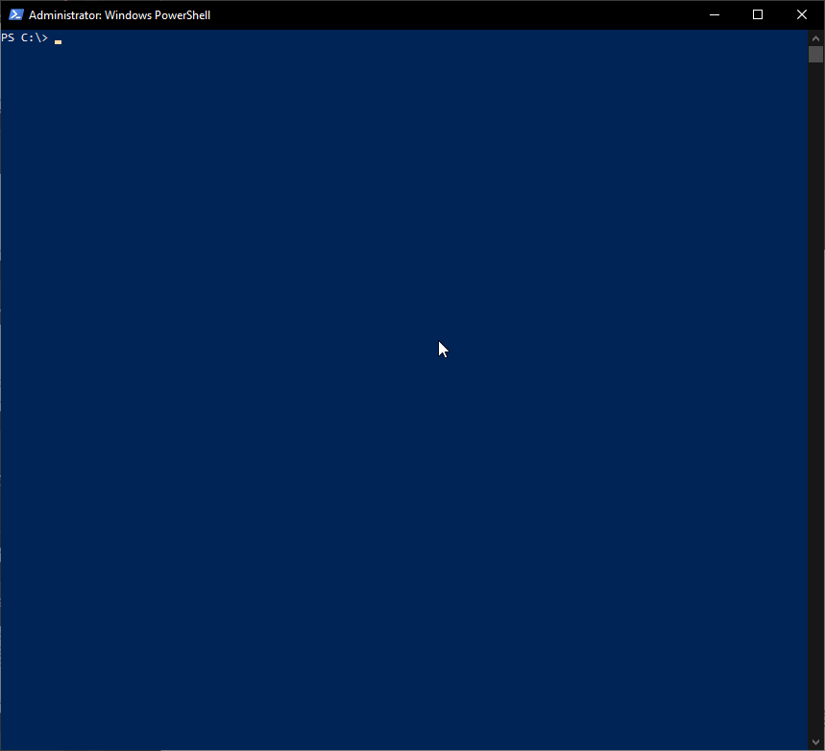
Get-Member
PS C:\> <cmdlet> | Get-Member
Caveat
PS C:\> Get-ADUser cthomas | Get-Member
vs.
PS C:\> Get-ADUser cthomas -Properties * | Get-Member
https://docs.microsoft.com/en-us/powershell/module/microsoft.powershell.utility/get-member

Slide 17
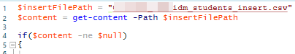
Import-CSV
SYNTAX:
Import-Csv –Path $insertFilePath
EXAMPLE:
$students = Import-Csv -Path $insertFilePath
https://docs.microsoft.com/en-us/powershell/module/microsoft.powershell.utility/import-csv

Slide 18
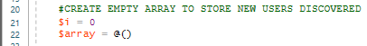
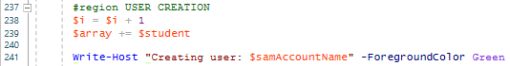
Export-CSV
SYNTAX:
Export-CSV –Path $exportCSVPath
EXAMPLE:
$array | Export-Csv -Path C:\IISD_IDM\IISD_NEW_STAFF_$currentDate.csv -NoTypeInformation -Append -Force
https://docs.microsoft.com/en-us/powershell/module/microsoft.powershell.utility/export-csv

Slide 19
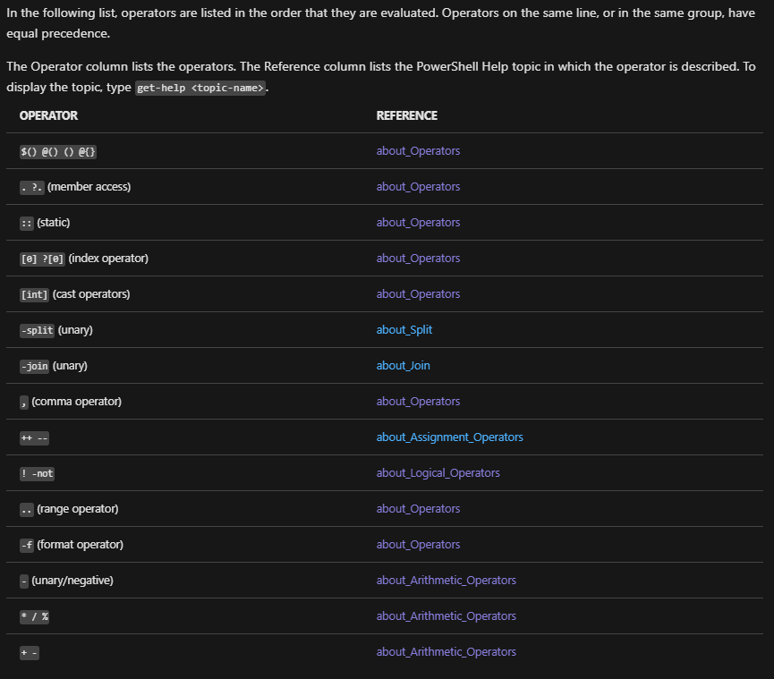
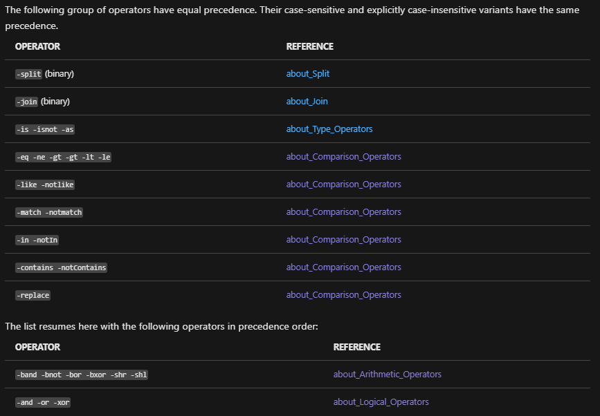
Flow Control Operators
About Operator Precedence
https://docs.microsoft.com/en-us/powershell/module/microsoft.powershell.core/about/about_operators

Slide 20
Flow Control Comparison Operators
By default, all comparison operators are case-insensitive. To make a comparison operator case-sensitive, add a c after the -. For example, -ceq is the case-sensitive version of -eq. To make the case-insensitivity explicit, add an i before -. For example, -ieq is the explicitly case-insensitive version of -eq.
-eq equals
-ne not equals
-gt greater than
-ge greater than or equal
-lt less than
-le less than or equal
-like returns $true if string matches wildcard
-notlike returns $true if string does not match wildcard
-match returns $true if string matches regex
-notmatch returns $true if string does not match regex
-contains returns $true if reference value in a collection
-notcontains returns $true if reference value not in a collection
-in returns $true if test value in a collection
-notin returns $true if test value not in a collection
-replace replaces a string pattern
-is returns $true if both objects are the same type
-isnot returns $true if the objects are not the same type
https://docs.microsoft.com/en-us/powershell/module/microsoft.powershell.core/about/about_comparison_operators

Slide 21
Flow Control Logical Operators
The PowerShell logical operators connect expressions and statements, allowing you to use a single expression to test for multiple conditions.
-and TRUE when both statements are TRUE
-or TRUE when either statement is TRUE
-xor TRUE when only one statement is TRUE
-not Negates the statements that follows
! Same as -not
https://docs.microsoft.com/en-us/powershell/module/microsoft.powershell.core/about/about_logical_operators

Slide 22
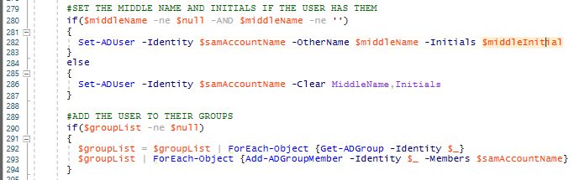
Flow Control Conditional Statements If / ElseIf / Else
SYNTAX:
If ( $thing –like “*$this*” ) { Do-Stuff }
https://docs.microsoft.com/en-us/powershell/module/microsoft.powershell.core/about/about_if

Slide 23
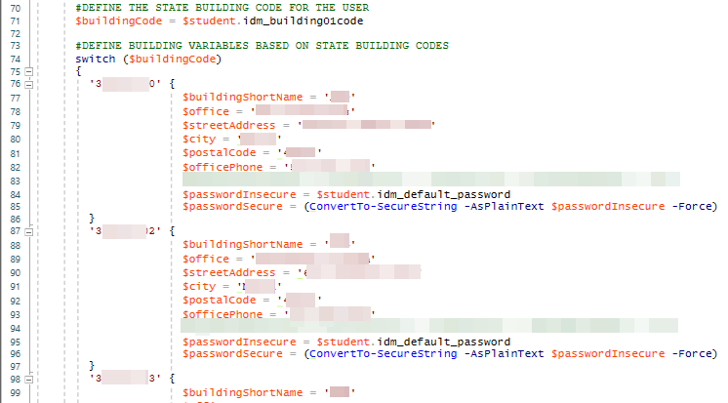
Flow Control Conditional Statements Switch
SYNTAX:
Switch ($thing)
{
Value1 { Do-Stuff }
default { Do-ThisStuffIGuess }
}
https://docs.microsoft.com/en-us/powershell/module/microsoft.powershell.core/about/about_switch

Slide 24
Flow Control Conditional Statements Where-Object
SYNTAX:
| Where-Object { $_.Property –eq Statement }
EXAMPLE:
Import-CSV –Path C:\scripts\students.csv | ? { $_.GradeLevel –eq ‘6’ }
https://docs.microsoft.com/en-us/powershell/module/microsoft.powershell.core/where-object

Slide 25
Flow Control Looping Statements foreach vs ForEach (ForEach-Object)
Getting to Know ForEach and ForEach-Object
Get-Help about_foreach
foreach is a language keyword
Less memory efficient
Faster results (if you have the memory for it)
Cannot pass output to another command via the pipeline
SYNTAX:
foreach ( $thing in $things ) { Do-Stuff }
EXAMPLE:
Measure-Command { foreach ( $i in ( 1..100000 ) ) { $i } }
Get-Help ForEach-Object
ForEach is shorthand for ForEach-Object
% is also shorthand for ForEach-Object
More memory efficient
Slower results
Can pass output to another command via the pipeline
SYNTAX:
ForEach-Object –InputObject $things –Process { Do-Stuff }
EXAMPLE:
Measure-Command { 1..100000 | ForEach-Object $_ }

Slide 26
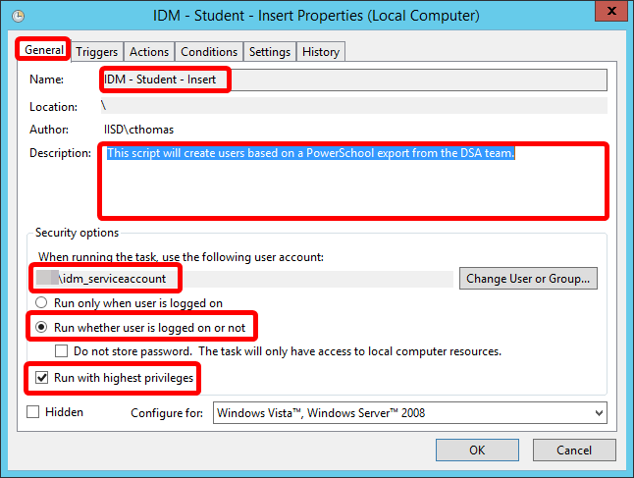
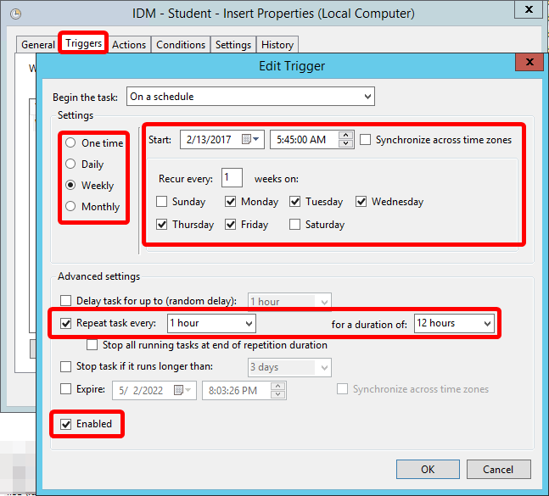
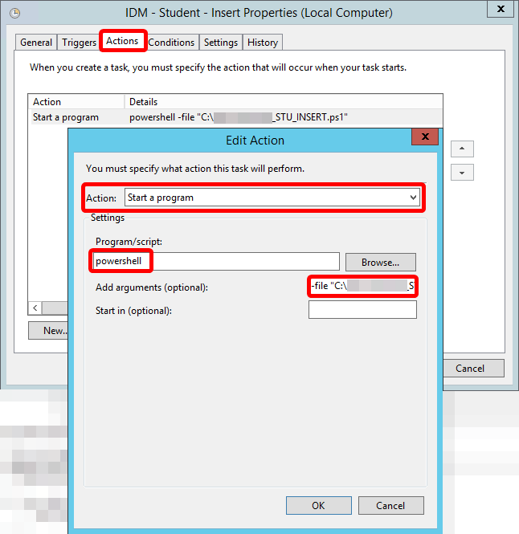
Task Scheduler
Run scripts on-demand until you are comfortable and then schedule them to run automatically so you can focus on other tasks
How to Schedule PowerShell Script using Task Scheduler
Use a service account with delegated permissions, not Domain Admin, to run your tasks
Active Directory Delegated Permissions Best Practices
Delegate AD group management

Slide 27
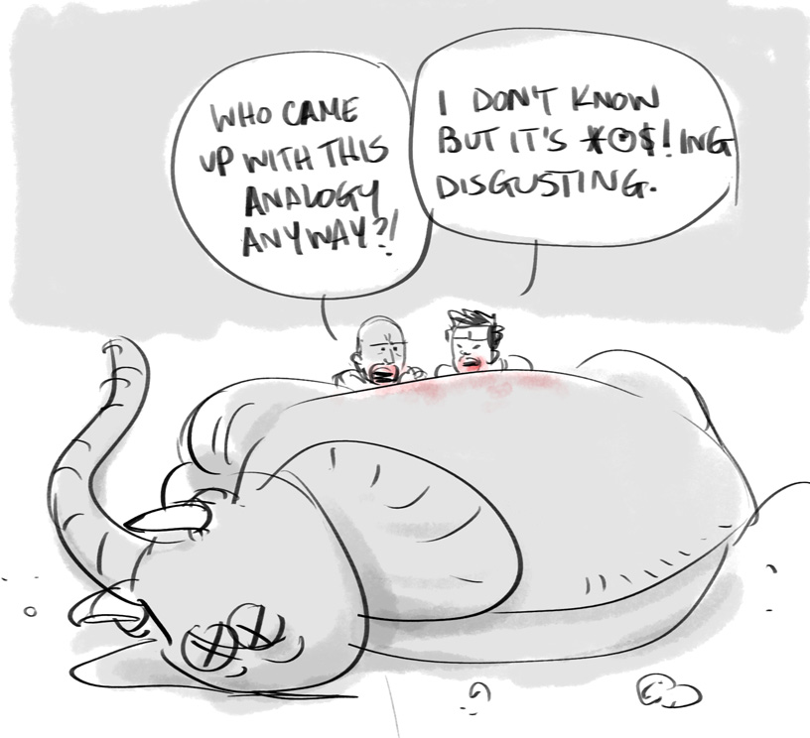
Automation End Goal
Provision
User account creation
Access
User account group membership
Consent
OAuth consent controls (O365 and Google)
Entitle
Automated license management
Federate
‘Sign in with Google’ or ‘Sign in with Microsoft’ vs. ‘Sign in with email address’
Personalize / Maintain
Name changes
Password self-service
User photos
De-Provision
User account disabling
User account access revocation
User account deletion
Sync
Azure AD Connect
Google Cloud Directory Sync

Slide 28
Provision

Slide 29
ADUC/ADAC
Manual
Does not scale
Potential for human error / typos
Potential to forget steps
Potential to lose processes over time / staff changes

Slide 30
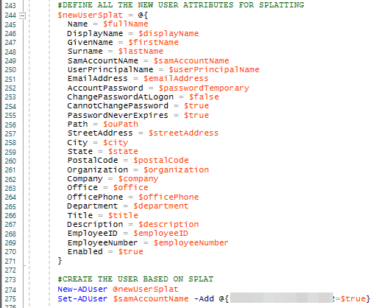
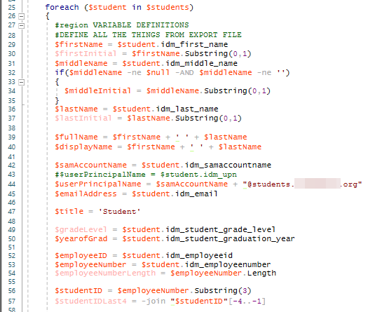
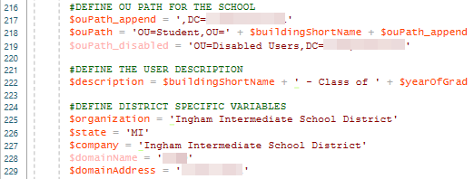
New-ADUser Multiple Users
Let’s pull everything together…
https://docs.microsoft.com/en-us/powershell/module/activedirectory/new-aduser

Slide 31



Don’t bite off more elephant than you can chew … Go throw that script in Task Scheduler! (using a service account with delegated permissions… not your account!)

Slide 32
Access

Slide 33
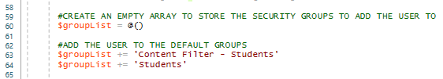
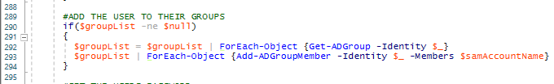
Add-ADGroupMember

Slide 34
Consent

Slide 35
OAuth Consent – Microsoft
Protecting your remote workforce from application-based attacks like consent phishing
Managing consent to applications and evaluating consent requests
Script to list all delegated permissions and application permissions in Azure AD
Disable all future user consent operations to any application
Configure how end-users consent to applications

Slide 36
OAuth Consent - Google
Take charge of your OAuth ecosystem with these best practices
Control which third-party & internal apps access Google Workspace data

Slide 37
Entitle

Slide 38
Group-based Licensing - Microsoft
Assign licenses to users by group membership in Azure Active Directory
PowerShell and Graph examples for group-based licensing in Azure AD

Slide 39
Group-based Licensing - Google
How licensing works
About automatic licensing for organizational units
GCDS: Manage & assign licenses

Slide 40
Federate

Slide 41
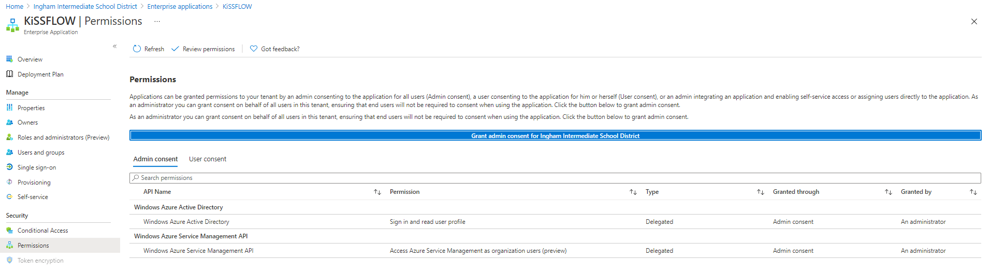
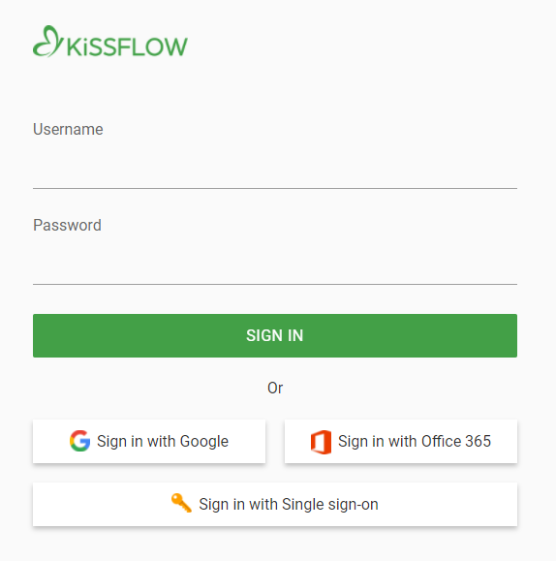
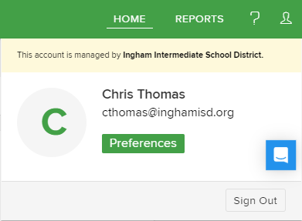
Sign-in with Microsoft / Office 365
Quickstart: Set up SAML-based single sign-on (SSO) for an application in your Azure Active Directory (Azure AD) tenant

Slide 42
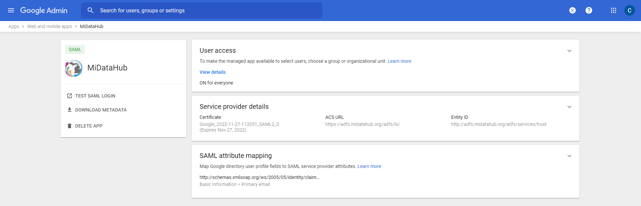
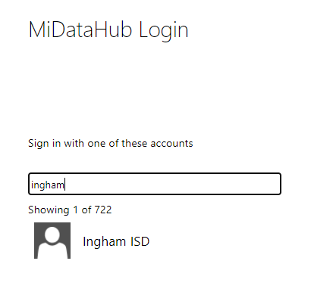
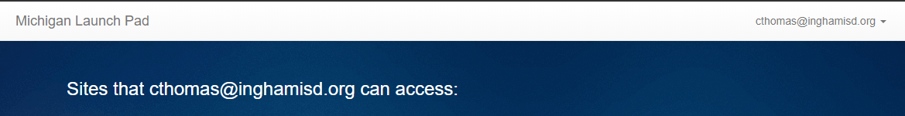
Sign-in with Google
https://support.google.com/a/answer/6087519?hl=en

Slide 43
Personalize / Maintain

Slide 44
Name Changes
Consider if/how you will support changing first names:
Christopher vs. Chris
William vs. Bill
Barbara vs. Barb
Margaret vs. Peggy
Secretary / Registrar Mistake
Consider if/how you will support changing last names:
Marriage / Divorce
Adoption
Secretary / Registrar Mistake
Consider only accepting changes through your authoritative source:
SIS for student data
HR system for staff data
What user object attributes will change if you support name changes?
DisplayName
GivenName / Surname
HomeDirectory
Mail
Name
SamAccountName
UserPrincipalName
What impact will user object attribute changes have on your environment?
How long will you support proxyAddresses for a user?
Are your online services flexible enough to support UserPrincipalName/SamAccountName/Mail changes and still retain the user's data/history?

Slide 45
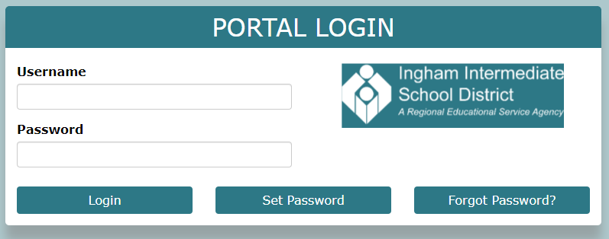
Password Self-Service
Consider if you will allow your students to change their passwords.
If so, what grade levels as this could affect how you create/manage users?
PortalGuard (paid product) or other on-prem solution that then syncs to cloud
Azure AD self-service password reset (SSRP) with Azure AD Connect Password Writeback (licensing required for each user who can use it, not tenant)
https://github.com/unosquare/passcore
https://github.com/pwm-project/pwm
Automate password resets with PWM
https://docs.microsoft.com/en-us/azure/active-directory/authentication/howto-sspr-deployment

Slide 46
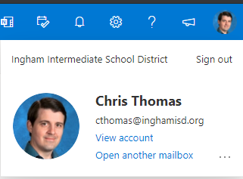
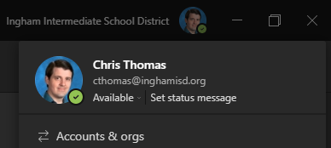
Set-UserPhoto
“Don’t Be A Nobody”
Outlook Prescence
Teams Prescence
https://docs.microsoft.com/en-us/powershell/module/exchange/set-userphoto

Slide 47
De-Provision

Slide 48
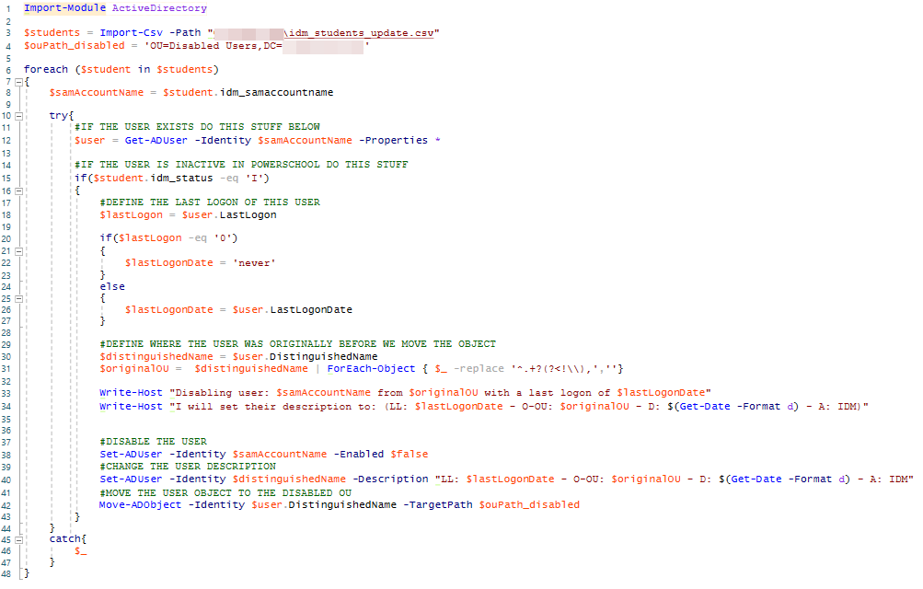
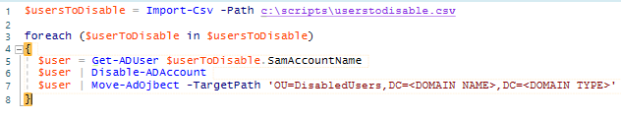
Disable-ADAccount or Set-ADUser –Enabled $false
Regularly check for and remove inactive user accounts in Active Directory
Understanding the AD Account attributes - LastLogon, LastLogonTimeStamp and LastLogonDate
https://docs.microsoft.com/en-us/powershell/module/activedirectory/disable-adaccount

Slide 49
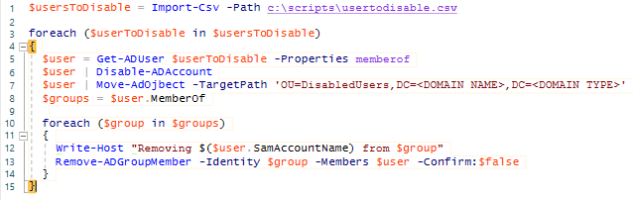
Remove-ADGroupMember
Consider auditing / logging the users current group memberships before stripping them of membership … just in case you need to revert the changes.
https://docs.microsoft.com/en-us/powershell/module/activedirectory/remove-adgroupmember

Slide 50

Remove-ADUser
Consider if you have Active Directory Recycle Bin enabled
Introduction to Active Directory Administrative Center Enhancements (Level 100)
Consider running manually and only automating if the organization has agreed to the filtering limits you’ve defined in your script.
https://docs.microsoft.com/en-us/powershell/module/activedirectory/remove-aduser

Slide 51
Sync

Slide 52
Azure AD Connect
What is Azure AD Connect?
Azure AD Connect sync: Understand and customize synchronization
Azure AD Connect and Azure AD Connect Health installation roadmap

Slide 53
Google Cloud Directory Sync (GCDS) Google Suite Password Sync (GSPS)
About Google Cloud Directory Sync
GCDS best practices
Active Directory user account provisioning
About G Suite Password Sync

Slide 54
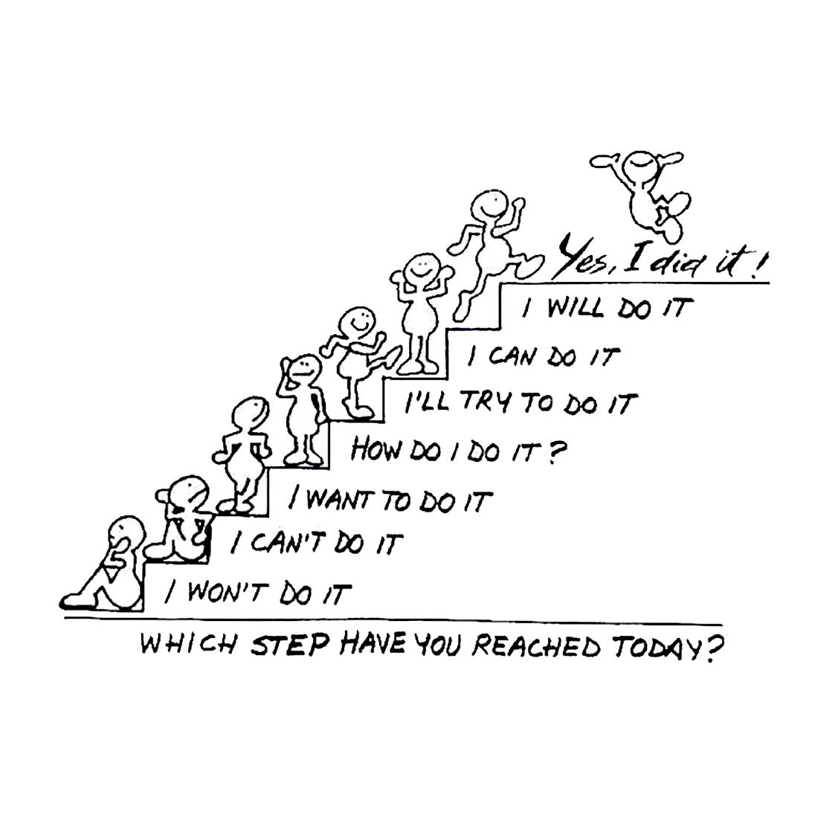
-- The End -- Ask Questions … … then go forth and iterate. PAST PRESENTATIONS: https://github.com/chrisATautomatemystuff/Presentations

